Slide 1


LOGIC Circuits

Slide 2
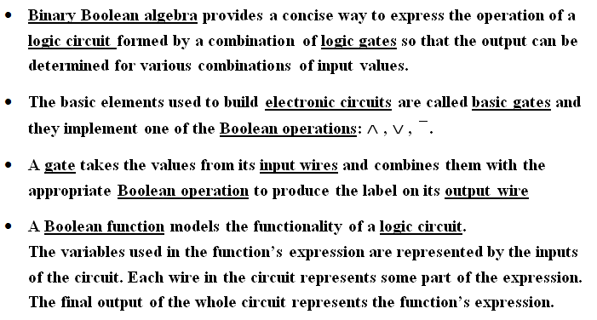
Logic Circuits

Slide 3
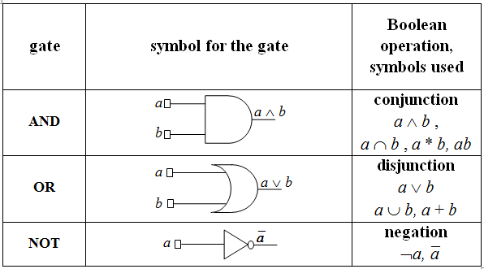
Basic gates – IEEE standards

Slide 4
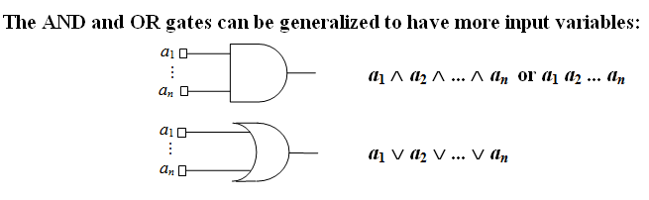
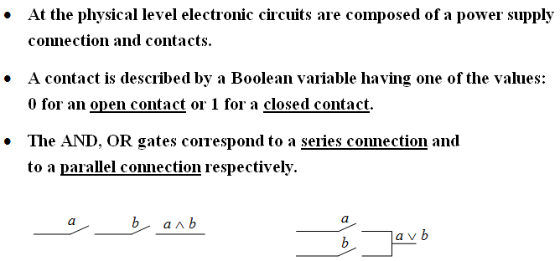

Slide 5
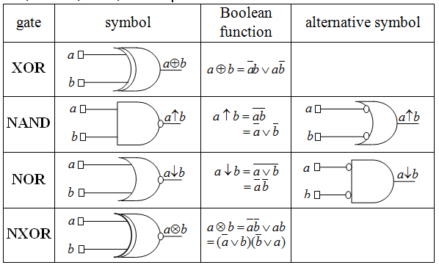
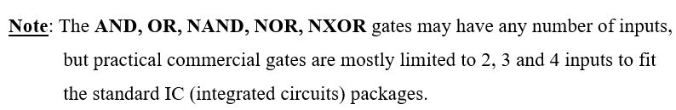
Derived gates: XOR, NAND, NOR, NXOR

Slide 6
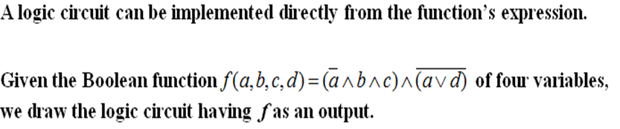
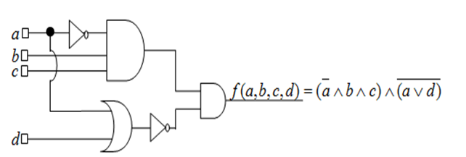
Example 1

Slide 7
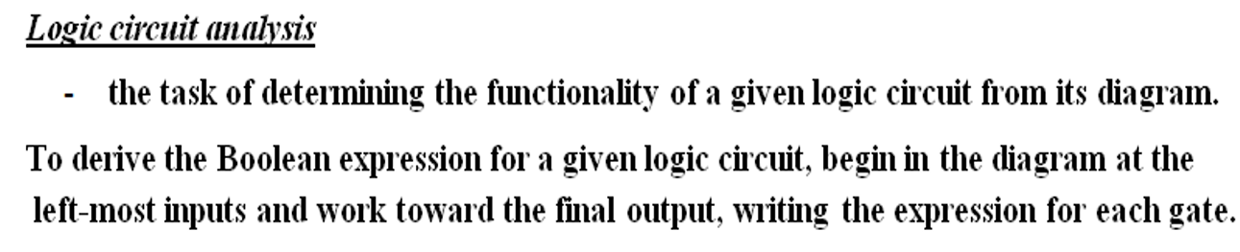
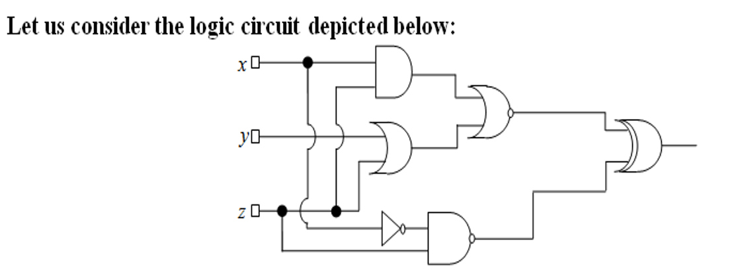




Example 2

Slide 8
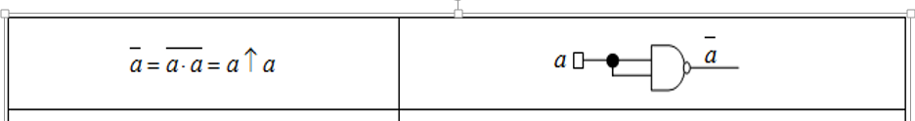
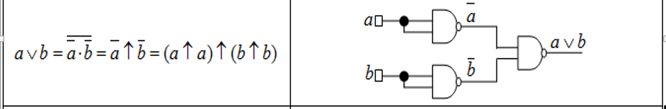
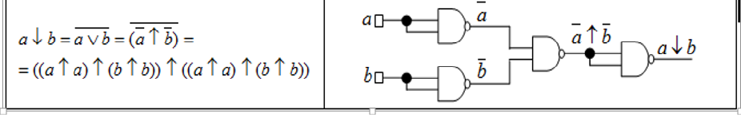
Example 3. NAND is a universal gate - it can be used to produce all the other gates

Slide 9
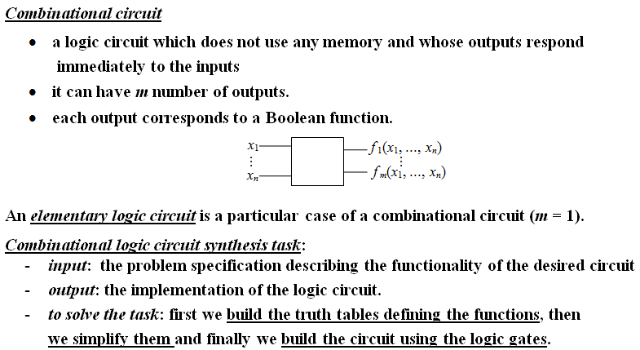
Combinational circuits

Slide 10
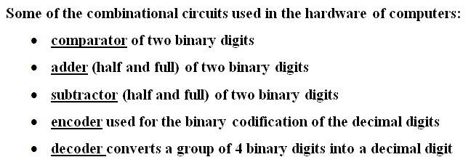
Examples of useful combinational circuits

Slide 11
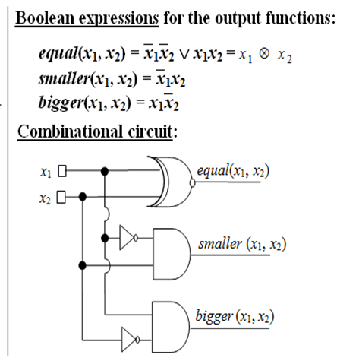
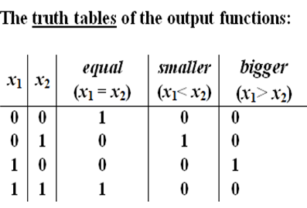
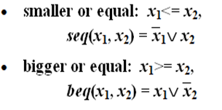
Example 4

Slide 12
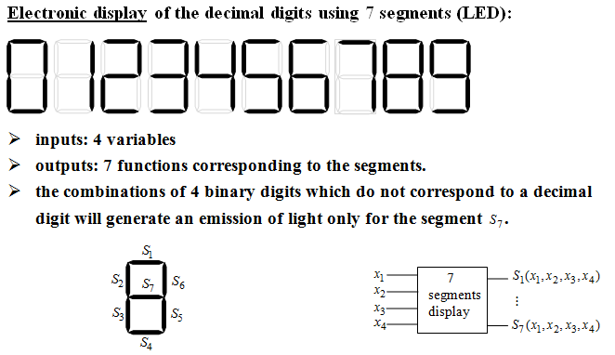
Example 5. 7 segments Circuit

Slide 13
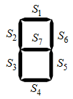
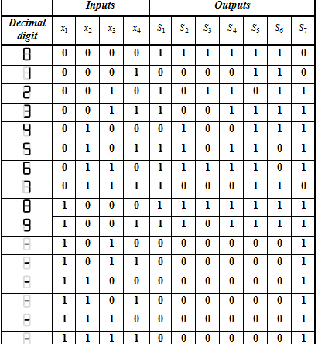


Example 5. 7 segments Circuit

Slide 14
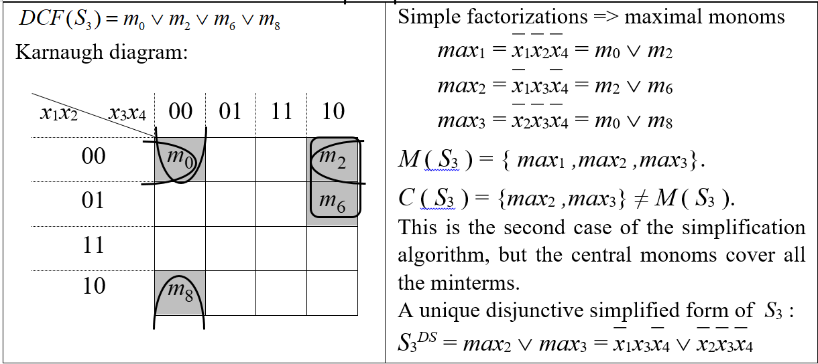
Example 5. Implement the Simplified Logic Circuit for S₃ using only NAND gates

Slide 15
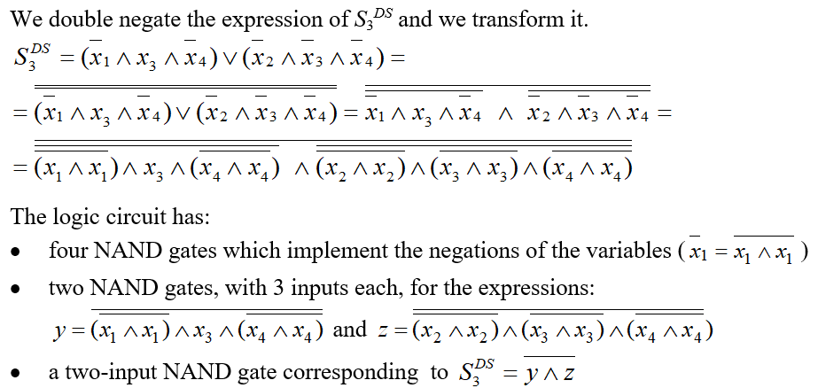
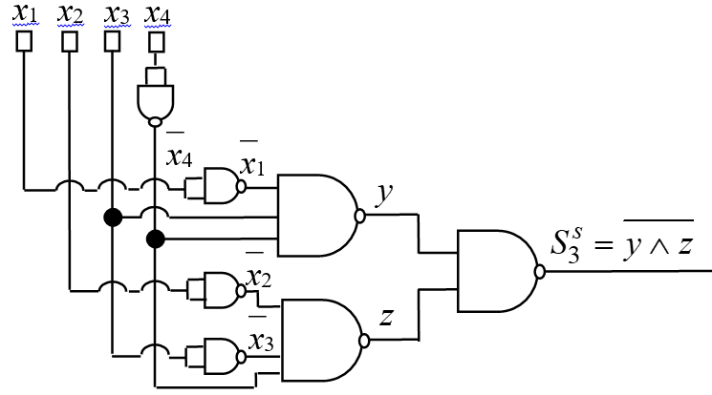
Example 5(contd.)

Slide 16
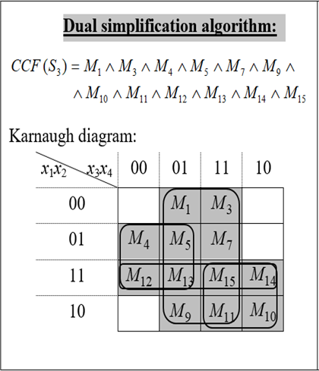
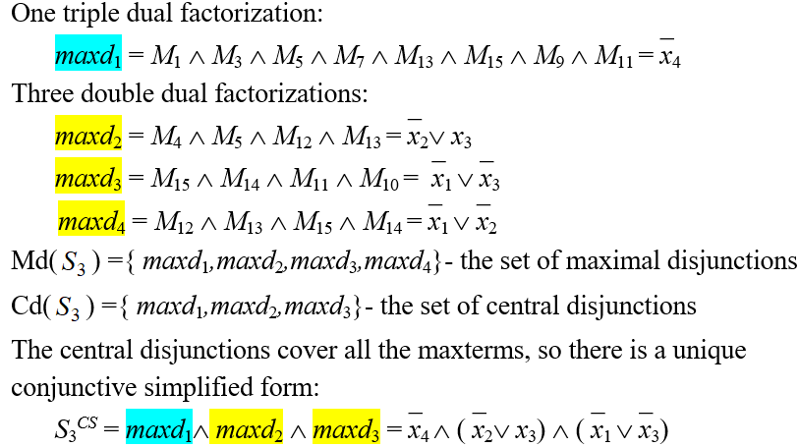
Example 5. Implement the Logic Circuit for S₃ using only NOR gates

Slide 17
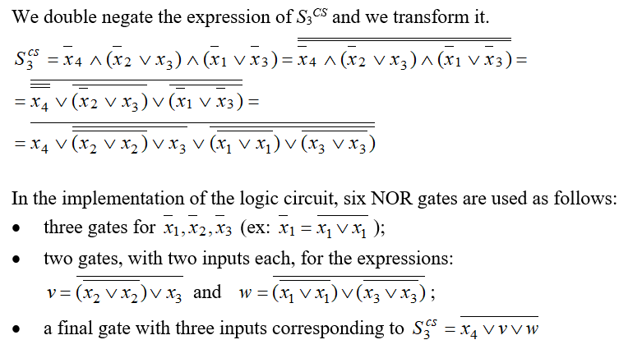
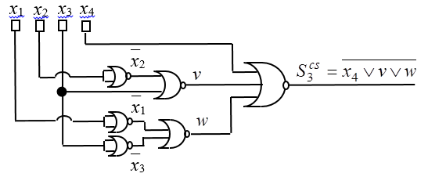
Example 5(contd.)

Slide 18


Slide 19



Slide 20
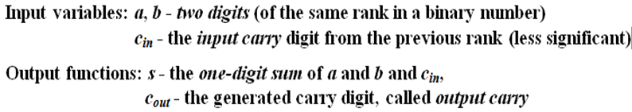
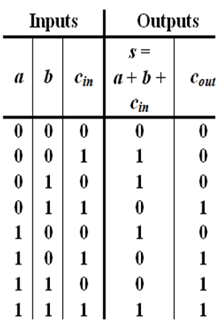
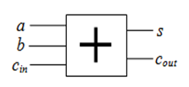
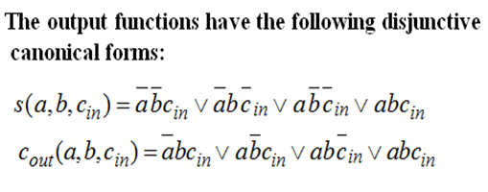
Example 6. Full Adder

Slide 21
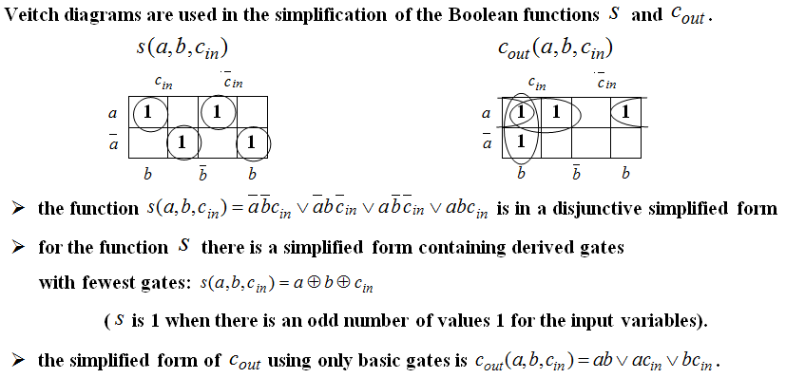
Example 6. Full Adder (contd.)

Slide 22
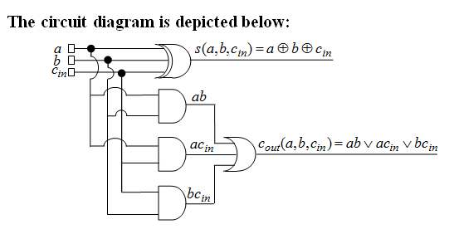
Example 6. Full Adder (contd.)

Slide 23
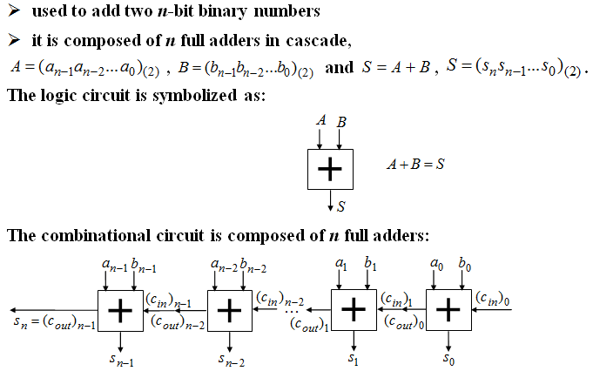
Example 7. n - bits adder

Slide 24
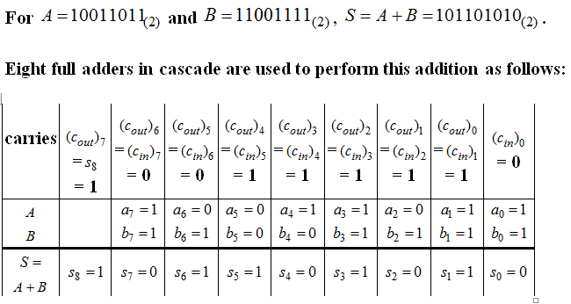
Example 7. n – bits adder (contd.)

Slide 25
Fun with logic circuits
Domino computer:
https://www.youtube.com/watch?v=w6E7aQnA4Ws
Marble adding machine
https://www.youtube.com/watch?v=GcDshWmhF4A
Water computer:
https://www.youtube.com/watch?v=IxXaizglscw
Logic gates using Gears, Marbles & Dominoes:
https://www.youtube.com/watch?v=kQeDnFUNW-Q
A Computer That Runs on Marbles:
https://www.youtube.com/watch?v=8BOvLL8ok8I

Slide 26
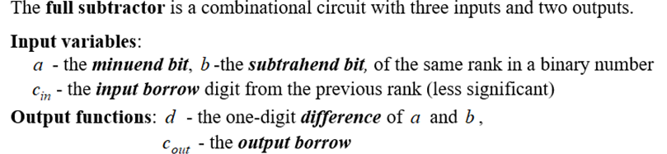
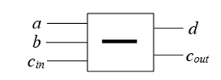
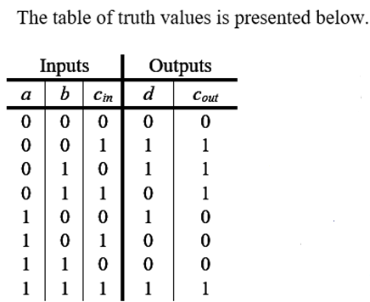
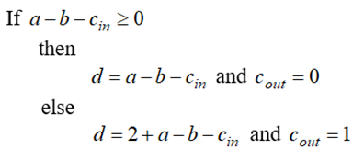
Example 8. Full Subtractor

Slide 27
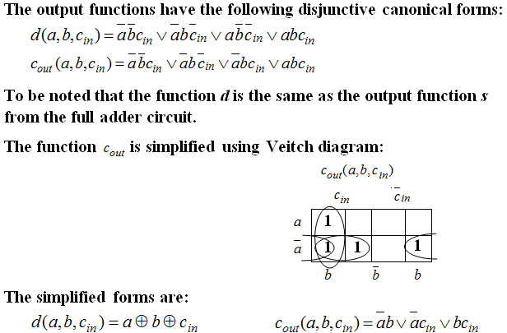
Example 8. Full Subtractor (contd.)

Slide 28
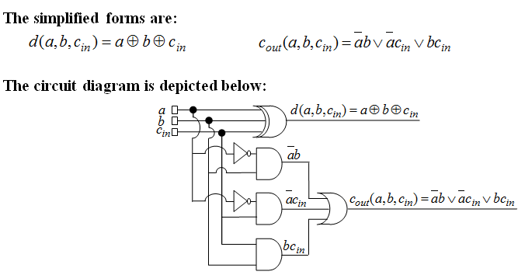
Example 8. Full Subtractor (contd.)

Slide 29
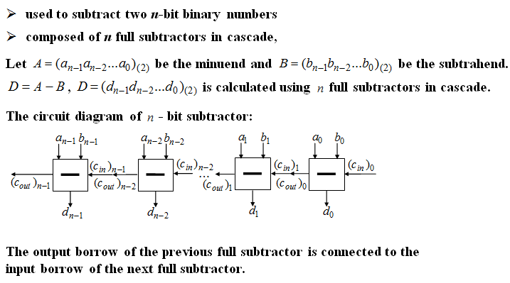
Example 9. n - bits subtractor

Slide 30
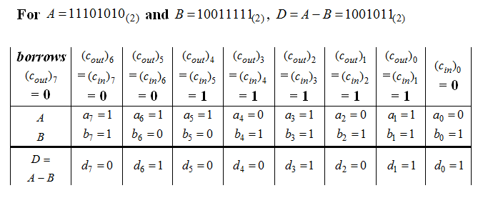
Example 9. n – bits subtractor (contd.)

Slide 31
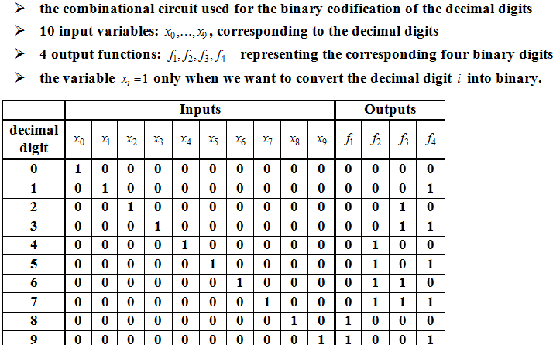
Example 10. Encoder

Slide 32
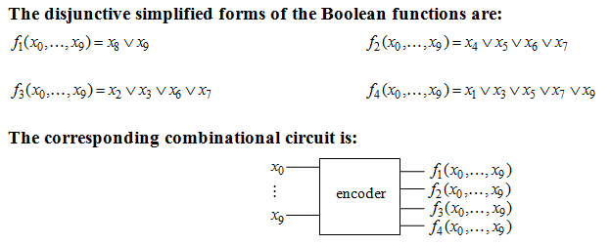
Example 10. Encoder (contd.)

Slide 33
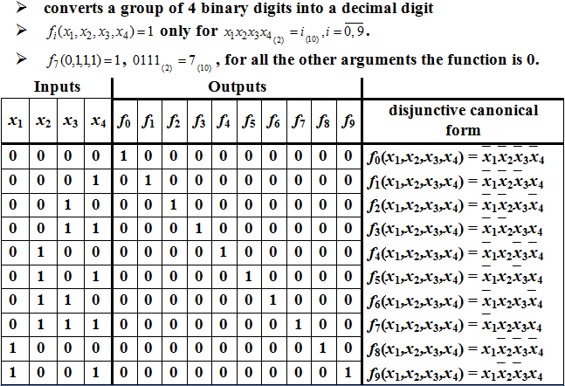
Example 11. Decoder

Slide 34
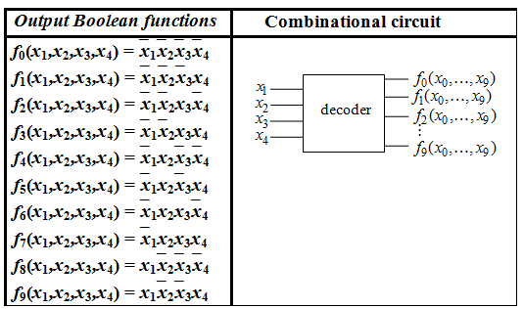
Example 11. Decoder (contd.)

Slide 35
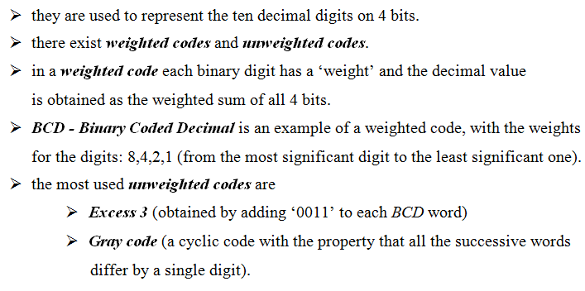
Binary codes

Slide 36
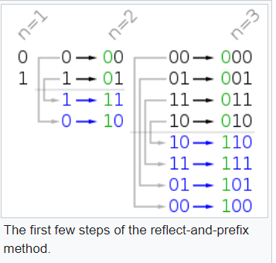
Gray Codes on n bits
The binary-reflected Gray code list for n bits can be generated recursively from the list for n − 1 bits by reflecting the list (i.e. listing the entries in reverse order), prefixing the entries in the original list with a binary 0, prefixing the entries in the reflected list with a binary 1.
Gray Codes are now widely used in digital communications, such as digital terrestrial television and some cable television systems, to aid in error correction and improve the signal’s overall quality.

Slide 37


Binary codes (contd.)

Slide 38


Example 12.

